Slide 1
Managing Developer Workflows with the Kubernetes API
Colin Murphy, Engineering Manager, Adobe

Slide 2

Managing Developer Workflows with the Kubernetes API
Colin Murphy is an engineering manager at Adobe. He is responsible for infrastructure engineering of Adobe Document Cloud microservices, including Adobe Sign and Acrobat Web.

Slide 3
Why?
Why write your own Kubernetes Client?
Greater control over the process.
Reduce cognitive load.
Interface with existing deployment systems and change management.
Secret Management.
It’s not that hard.
Notes:
Why write your own Kubernetes client.
Why not Spinnaker or just kubectl.

Slide 4

Greater Control
Notes:
Keep engineers from breaking their stuff.
Limit Kubernetes objects.
Apply labels.
Ensure there are no resource conflicts.
You should still use restrictions on the server side as well. OPA, RBAC, Network Segmentation.

Slide 5
Greater Control
Application Engineers
DC Infrastructure Team
100:1
SRE/OPS
30:1
Notes:
Keep engineers from breaking their stuff.
Limit Kubernetes objects.
Apply labels.
Ensure there are no resource conflicts.
You should still use restrictions on the server side as well. OPA, RBAC, Network Segmentation.

Slide 6
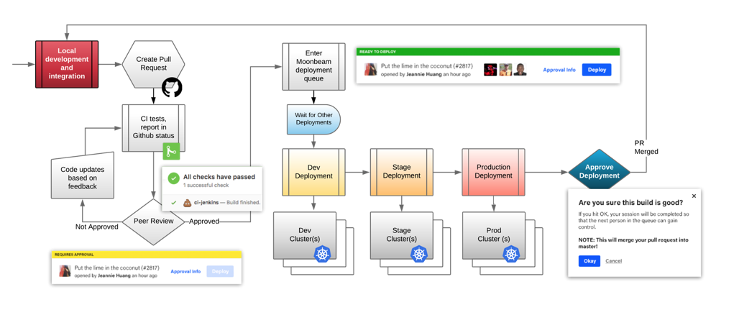
Interface with existing deployment systems.
Content
Notes:
https://github.blog/2012-08-29-deploying-at-github/
At a company as old and large as Adobe, there is no such thing as ”Green Field”.
Change Management.

Slide 7
Reduce Cognitive Load
Application Engineers
Deep technical knowledge in a specific domains of knowledge.
Don’t have time to learn Kubernetes.
Site Reliability Engineers / Ops
Focused on high touch, legacy infrastructure.
Primary On-Call.
Responsible for Change Management, HIPAA/SOC2/PCI compliance.
Don’t have time to learn Kubernetes.

Slide 8
Template
Application Engineers
Deep technical knowledge in a specific domains of knowledge.
Don’t have time to learn Kubernetes.
Site Reliability Engineers / Ops
Focused on high touch, legacy infrastructure.
Primary On-Call.
Responsible for Change Management, HIPAA/SOC2/PCI compliance.
Don’t have time to learn Kubernetes.

Slide 9
Secret Management
Vault path validation.
No connection from cluster to corporate secret stores.
Application engineers should not be able to see production secrets.

Slide 10
It’s not hard.
Notes:
At least at first.

Slide 11
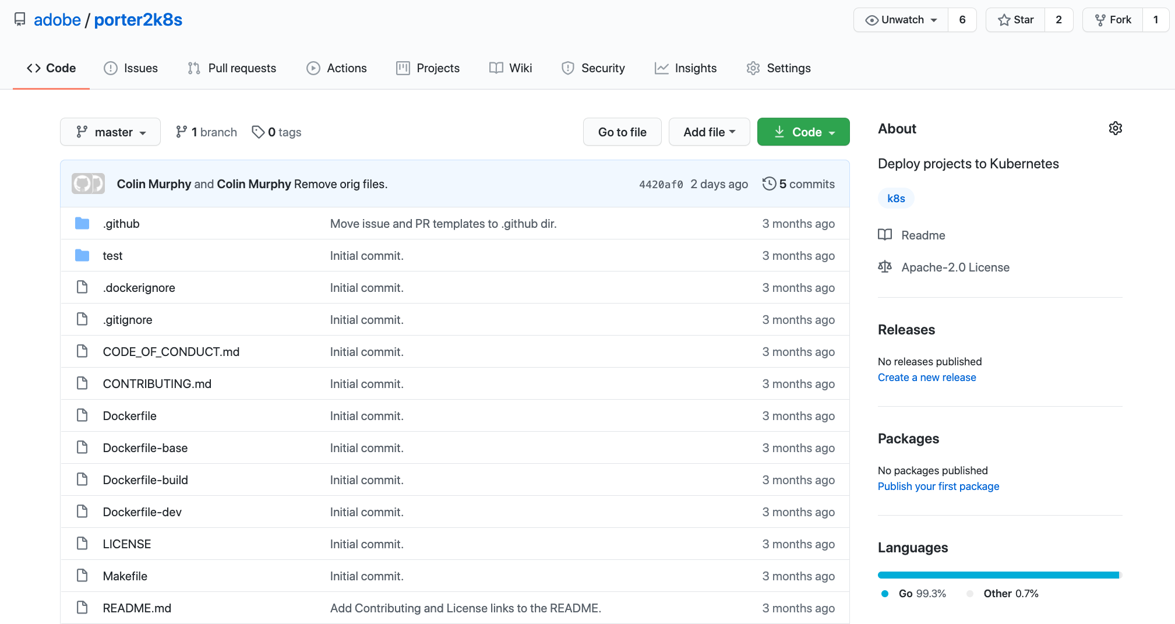
github.com/adobe/porter2k8s
https://github.com/adobe/porter2k8s

Slide 12
Requirements
Existing service configuration.
Low learning curve / High Ceiling.
One repo per microservice: configuration, objects, code in the repository.
Secrets and ConfigMaps explicitly tied to deployment.
Multi-region, heterogenous clusters.
Notes:
Carry over existing service configuration.
The onboarding system generates enough to get started.
Domains of control. Application engineers have write permissions over their repositories. We don’t want them having to go somewhere else or use a different system to make changes to their repositories.

Slide 13

Low Learning Curve / High Ceiling
Notes:
The onboarding system generates enough to get started.

Slide 14
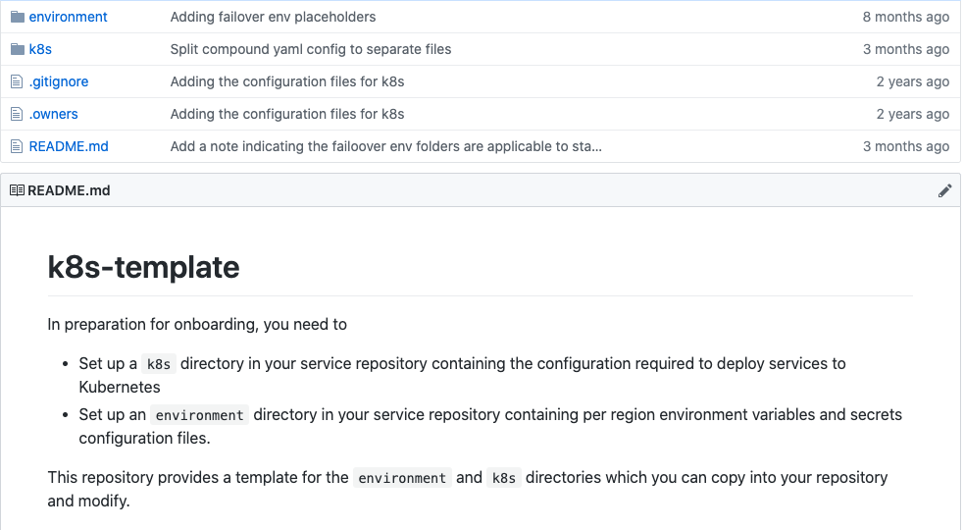
One Repo per Microservice
Notes:
Segmentation of responsibilities.
Application engineers have write permissions over their repositories. We don’t want them having to go somewhere else or use a different system to make changes to their repositories.

Slide 15

Hermetic Deployments
Notes:
Hermetic Builds -> Deployments

Slide 16
Heterogeneous Clusters
Read cluster unique configuration and modify objects accordingly.

Slide 17
How?
Process
Inputs: clusters, namespace, image tag
Load service environment variables, fetch secrets.
Read objects from application repository.
Read cluster configuration from target clusters.
Update the Kubernetes objects as required.
Notes:
Inputs are determined by build system.

Slide 18
Environment Entry Types
Environment Variables
Porter2k8s Template Variable Overrides
Vault Secret Paths
Kubernetes Secret References
Notes:
Step 1 Gather environment variables
Scalable – multiple clusters
Kubernetes secrets names must contain the service name.
Vault paths must contain the secret name.

Slide 19
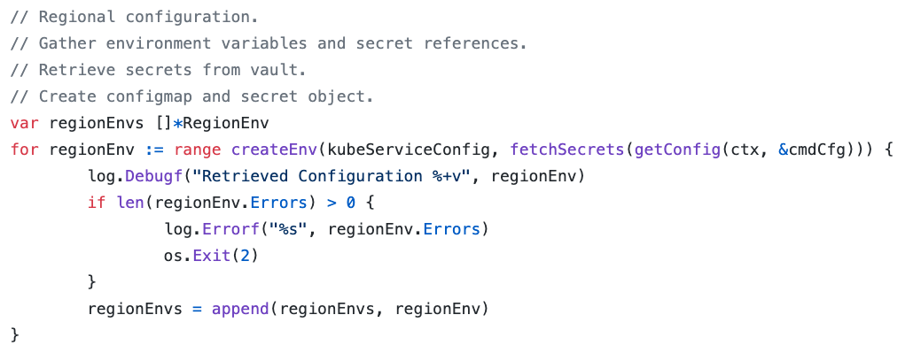
Read Configuration
Notes:
Pipelines from Katherine Cox-Buday. Concurrency in Go, 2017

Slide 20
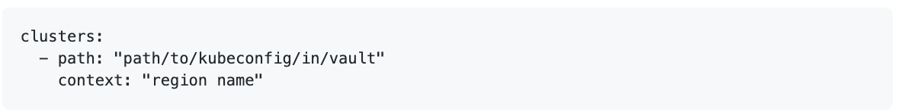
Kubeconfig
Notes:
Porter2k8s can deploy using multiple kubeconfig files stored in Vault. This feature is enabled if cluster-config.yaml is found in the root of the $CONFIG_PATH.
In Vault, the key must be config and the value the base64 encoded kubeconfig file. For example:

Slide 21
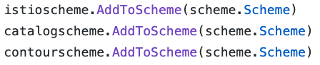
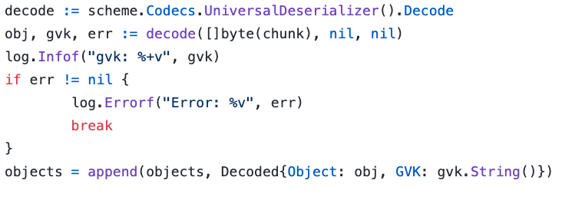
Decoding Objects
Notes:
For now we use schemes and clientsets. Easier to modify.

Slide 22
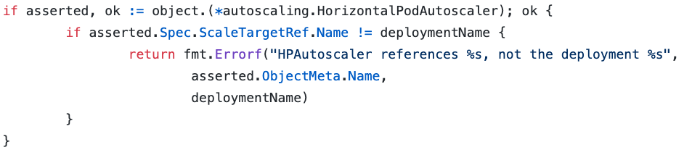
Object Validation
Notes:
For now we use schemes and clientsets. Easier to modify.

Slide 23
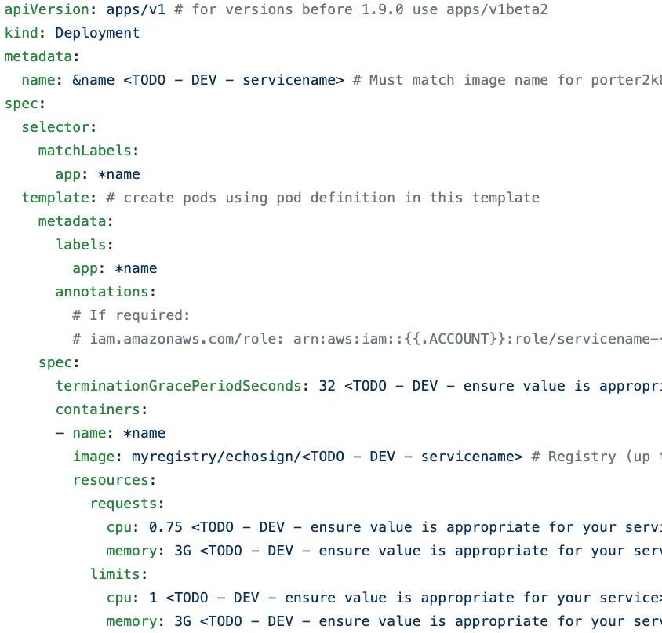
Object Validation
Notes:
As I mentioned these can be overridden by the service configuration.
As the permutations expand, we will be supplementing with object labels or annotations.
Additionally the container image of the deployment or job is tagged with the git SHA which was passed as an argument to porter2k8s.
This assumes such an image tag exists.

Slide 24
Cluster Settings
DOMAIN
REGISTRY
ISTIO
GATEWAYS
HPAMIN
CLOUD
CLOUD_LOCATION
Notes:
As I mentioned these can be overridden by the service configuration.
As the permutations expand, we will be supplementing with object labels or annotations.
Additionally the container image of the deployment or job is tagged with the git SHA which was passed as an argument to porter2k8s.
This assumes such an image tag exists.

Slide 25
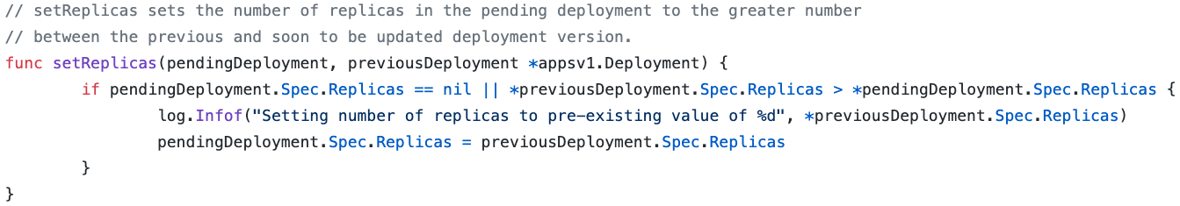
Compare
Notes:
We need to be careful with updates, so we don’t compare everything especially with service instances.
Since we use the typed clientset comparisons are very straightforward.

Slide 26
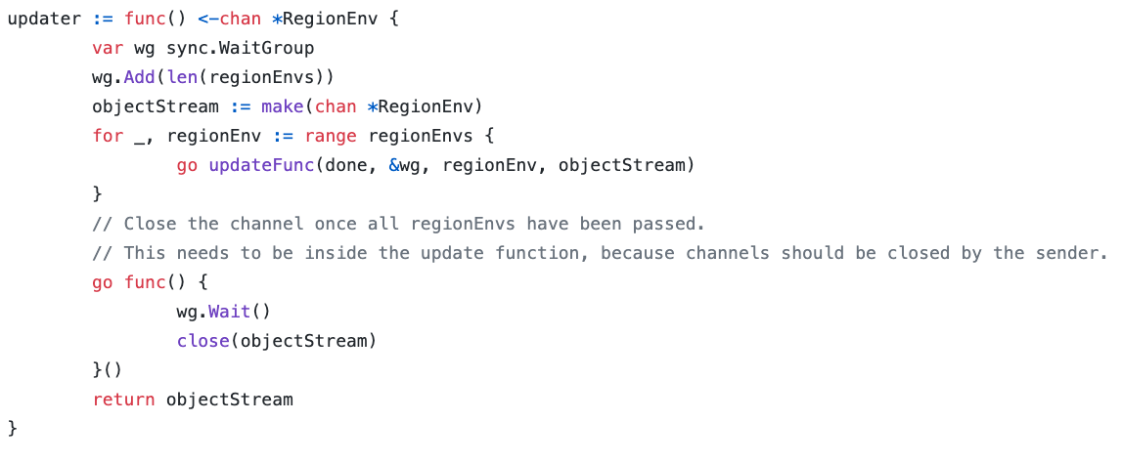
Update
Notes:
We need to be careful with updates, so we don’t compare everything especially with service instances.
Since we use the typed clientset comparisons are very straightforward.

Slide 27

Looking Ahead
Notes:
Unstructured
Dynamic Kubernetes Client

Slide 28
Future Work
Dynamic Client for AWS Controller for Kubernetes (ACK) and Azure Service Operator (ASO)
Label Based Conditional Object Deployment
Notes:
Unstructured
Dynamic Kubernetes Client

